Slide 1
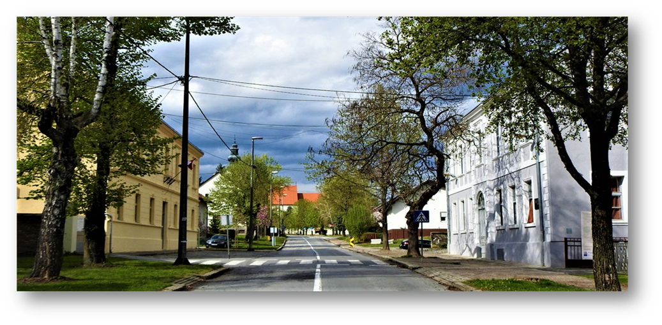
Mate Lovrak
Primary school
Kutina - Croatia

Slide 2
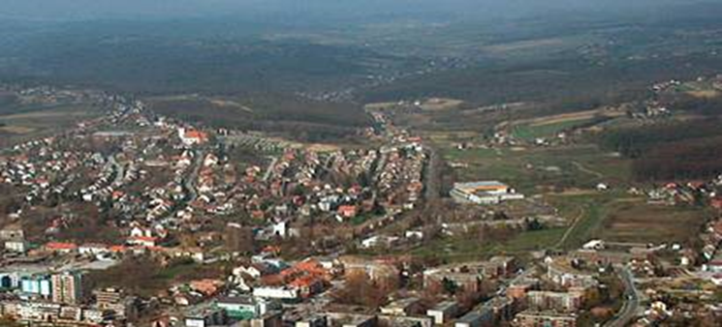
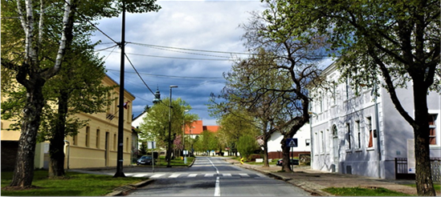
MATE LOVRAK PRIMARY SCHOOL -
located in the northern part of the city

Slide 3
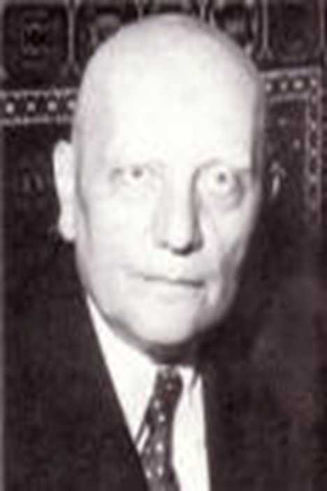
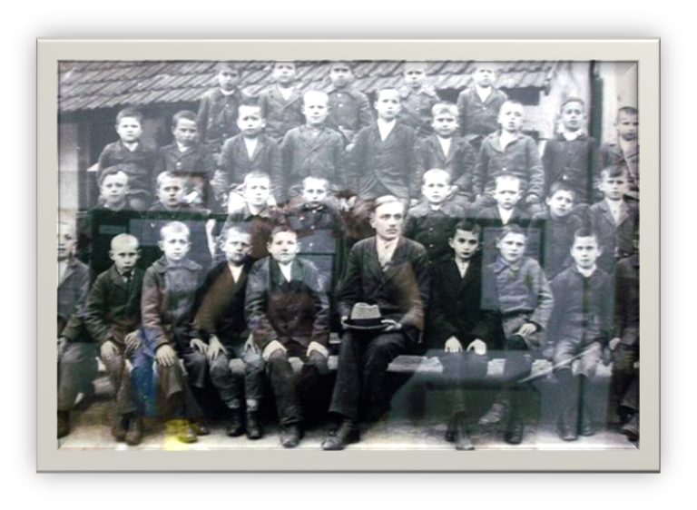
The school is named after well-known Croatian writer Mato Lovrak
He used to work at our school as a teacher - 1920.

Slide 4
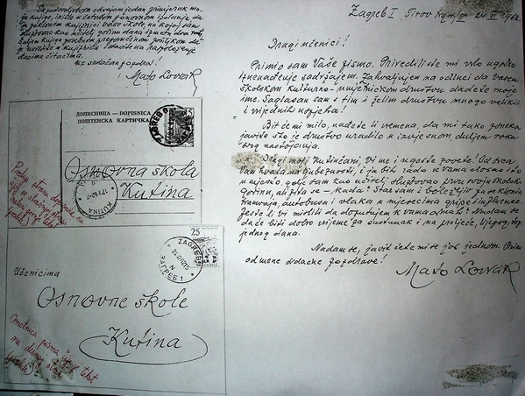
Letters from Mato Lovrak to students of our school - 1962.god.

Slide 5
Our school is a realy old lady
It was built in 1789.
This year we are celebrating the 235th anniversary of the school.
We are proud that our school is in a historical monument category.
With the support of European funds, the school was renovated and although very old - today it is a very modern school with modern teaching methods.

Slide 6
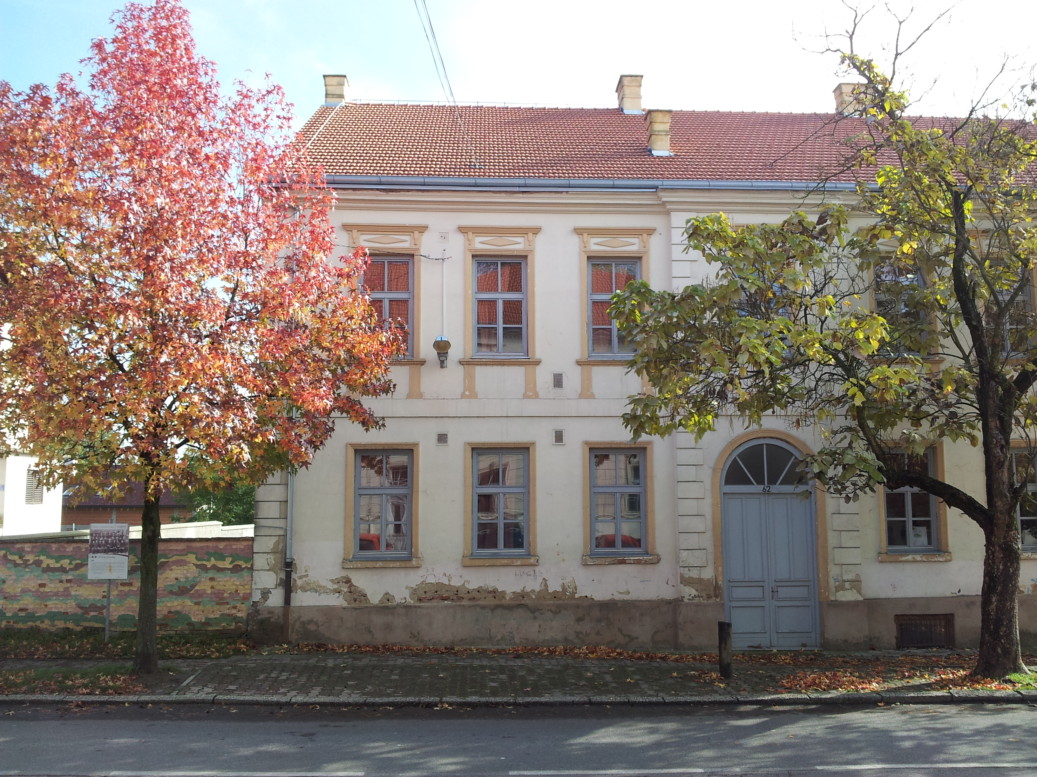
Before renovation :

Slide 7
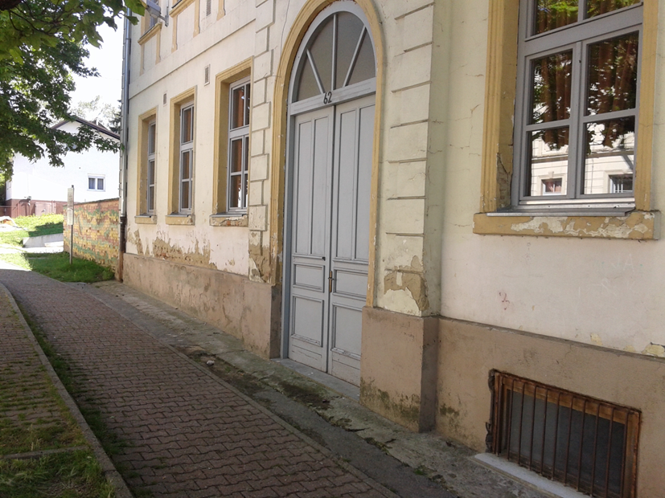

Slide 8
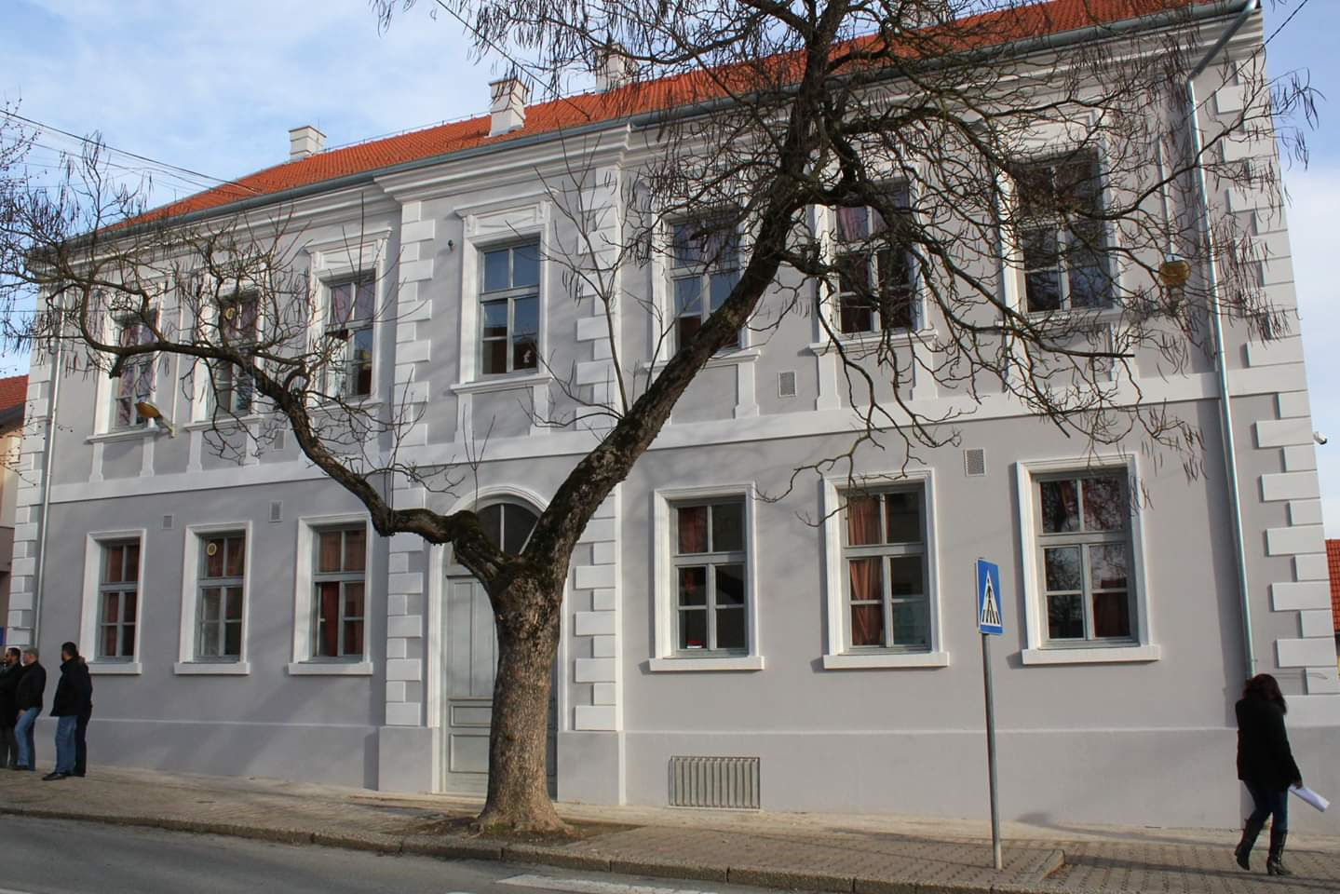
After renovation :

Slide 9
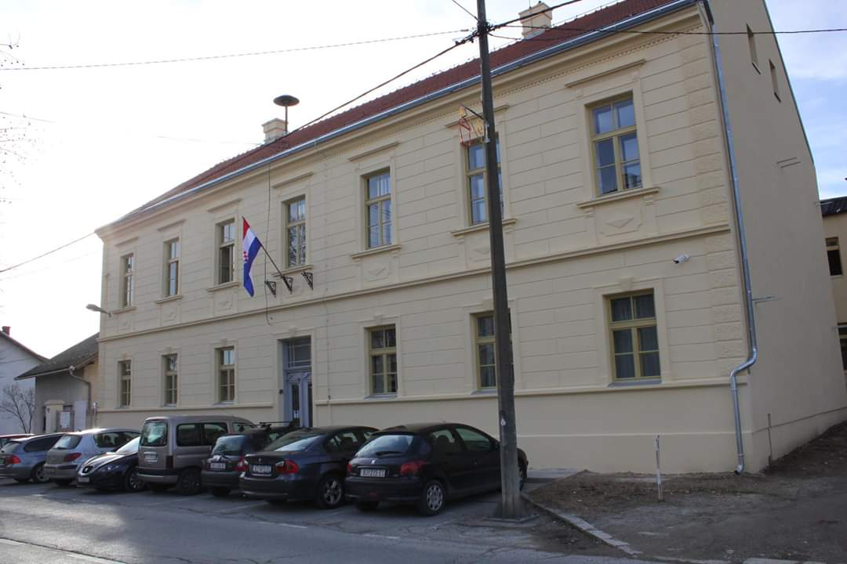

Slide 10

School LOGO

Slide 11
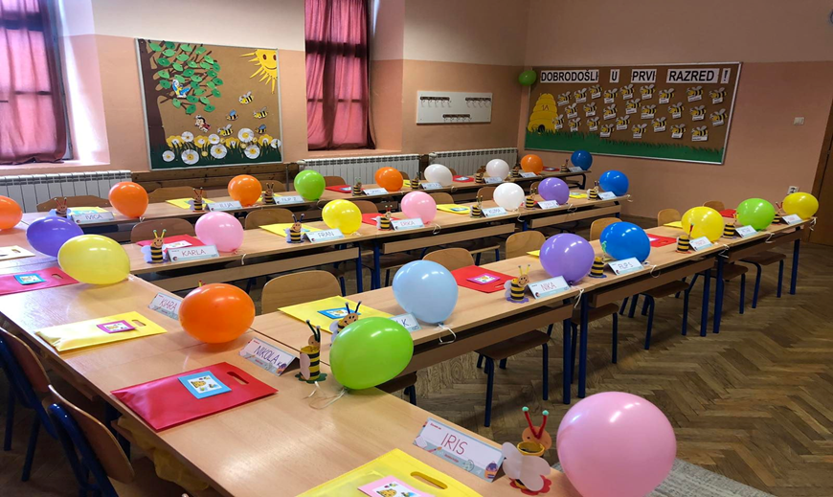
The school is attended by students aged 6–14 years
There are about 400 students in the school.

Slide 12
Teaching & activities :
We have obligatory subjects and elective courses like German, Religion and Computer Science.
We also offer various extracurricular activities : Astronomy, Computer Science, Choir, School Band, Art, various sports, Contemporary Dance, Drama, Journalism, Literary Club, Ecology, Italian Language, Traditional Skills, Household…etc.
Pupils participate in numerous competitions and achieve excellent results.

Slide 13
PROJECTS
we participate in numerous projects organized by the Ministry of Science and Education, the county, the city or in our school projects. We have also been active in e-Twinning projects for a decade now, and we have ongoing Erasmus projects as well.
Through the e-school project and STEM-alphabet of the future project, we received numerous IT equipment, which makes us the most modern school in the Republic of Croatia at the moment. Each class has its own desktop computer, projector, smart board, whiteboard. The IT classroom has 22 laptops and desktop computers for students. We have VR glasses, 3-d projectors, etc.

Slide 14
OŠ MATE LOVRAKA, KUTINA
http://os-mate-lovraka-kt.skole.hr/
https://www.facebook.com/p/Osnovna-%C5%A1kola-Mate-Lovraka-Kutina-100063616061946/?locale=hr_HR

Slide 15
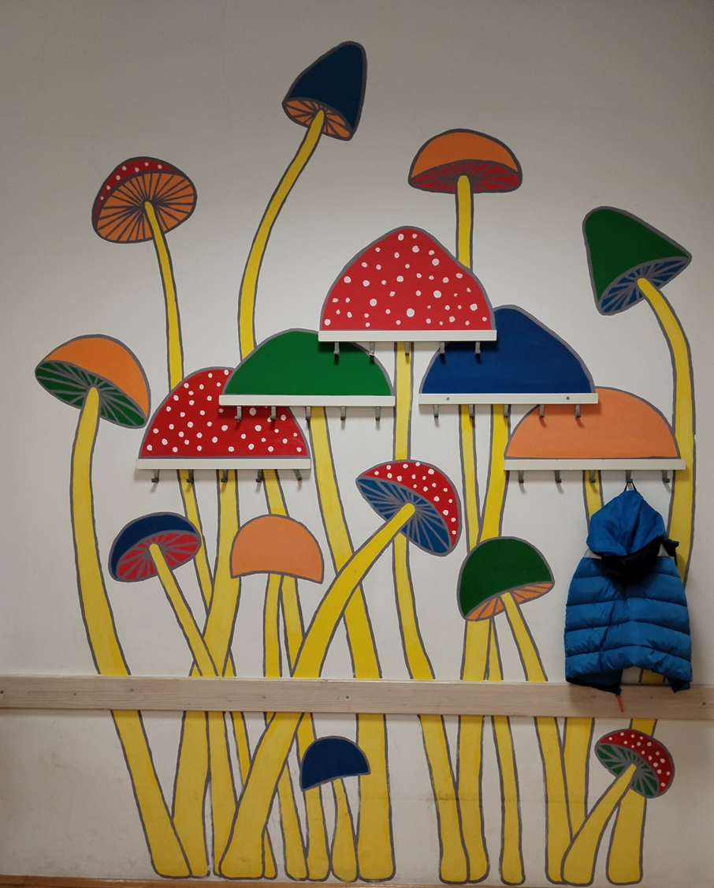
A short photo tour through school and activities …

Slide 16
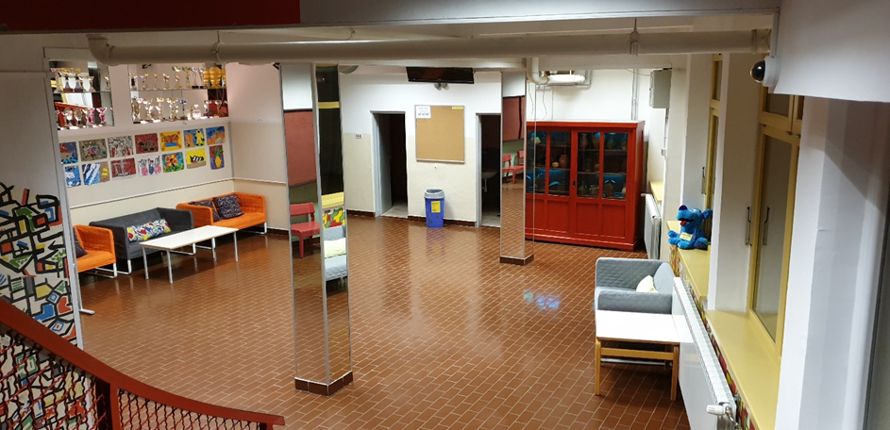

Slide 17
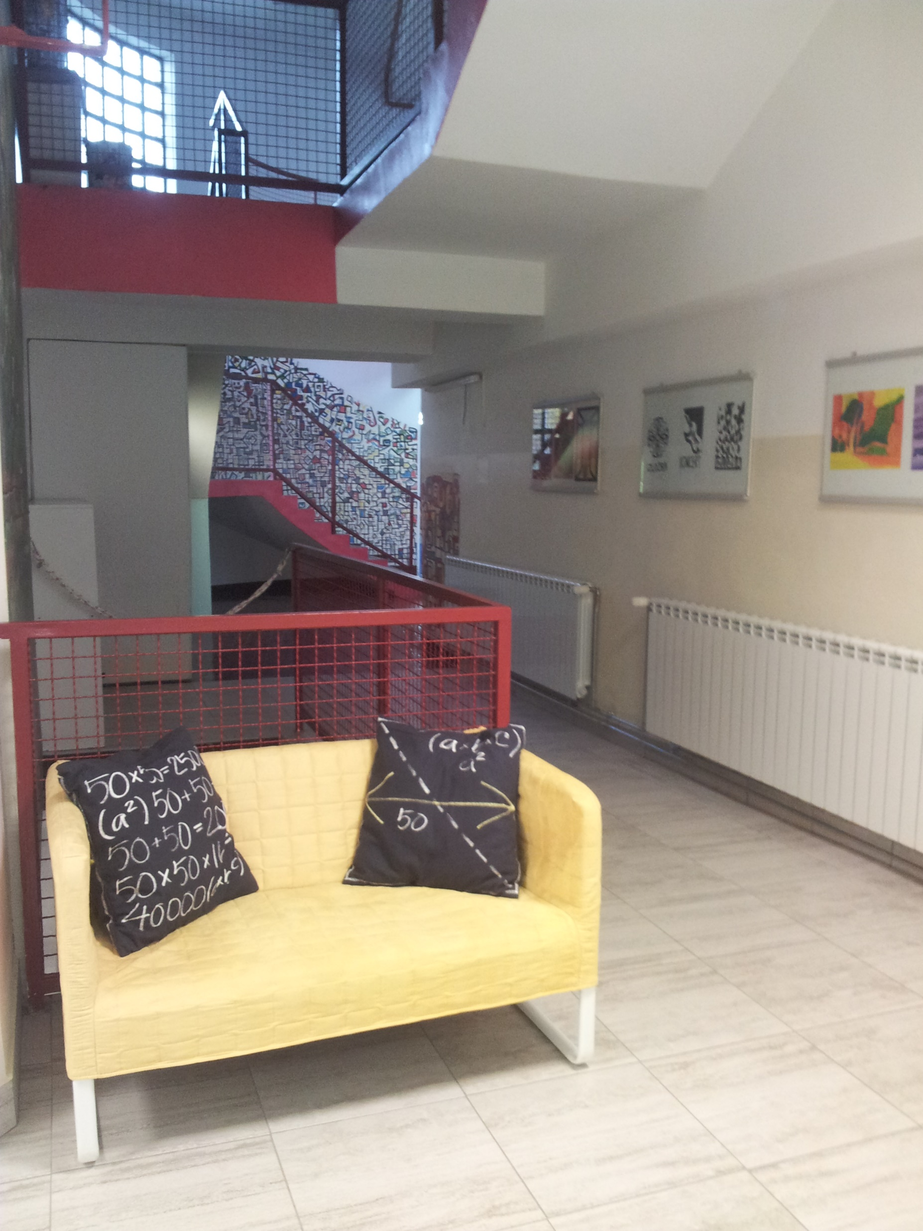

Slide 18
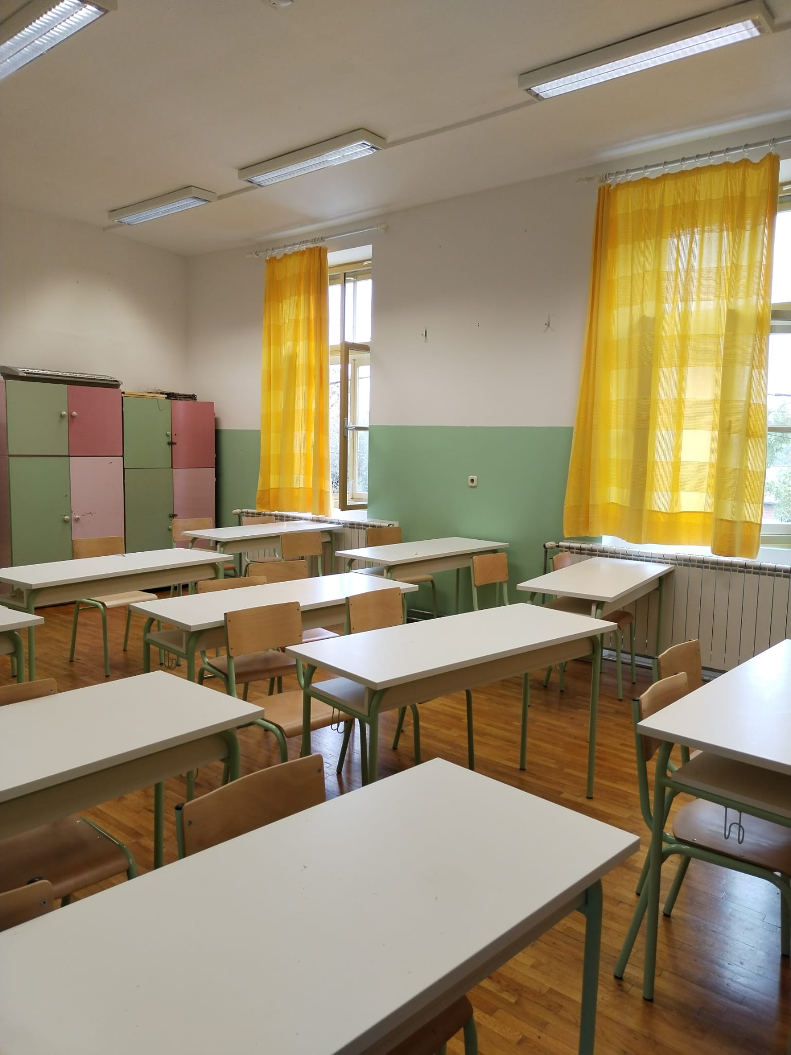

Slide 19
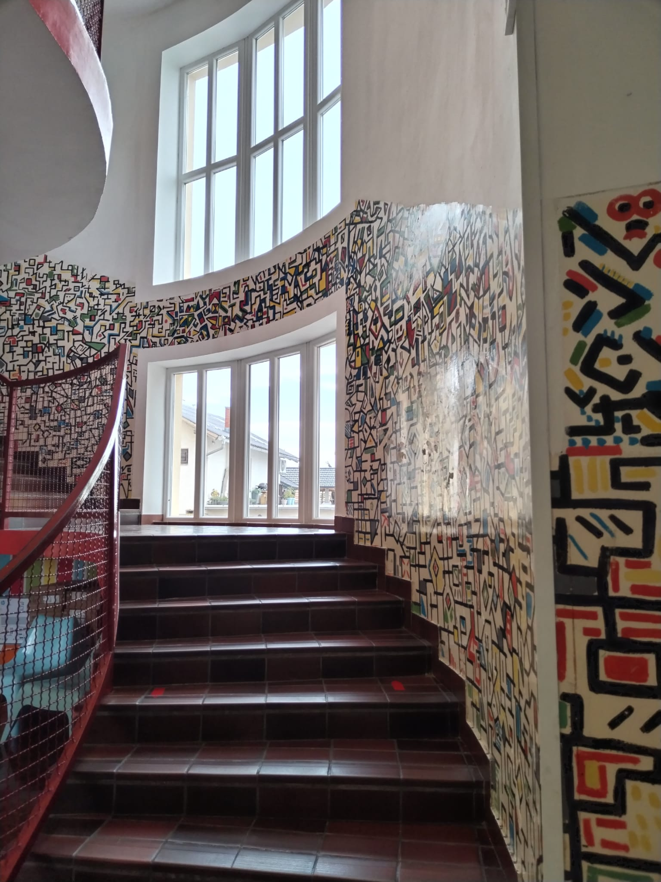

Slide 20
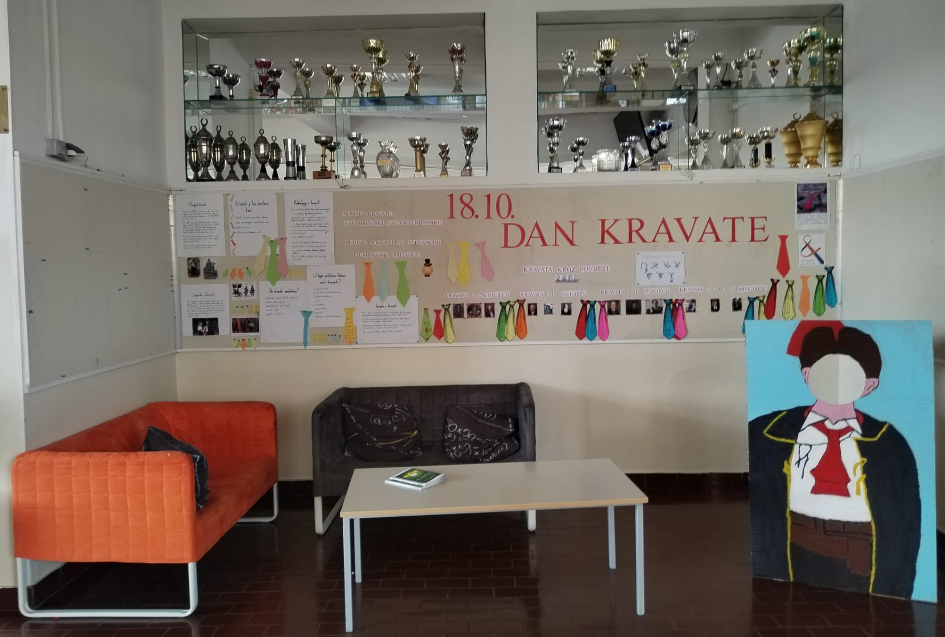

Slide 21
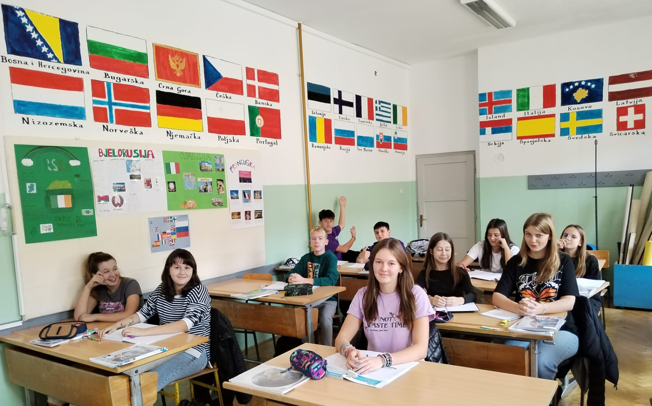

Slide 22
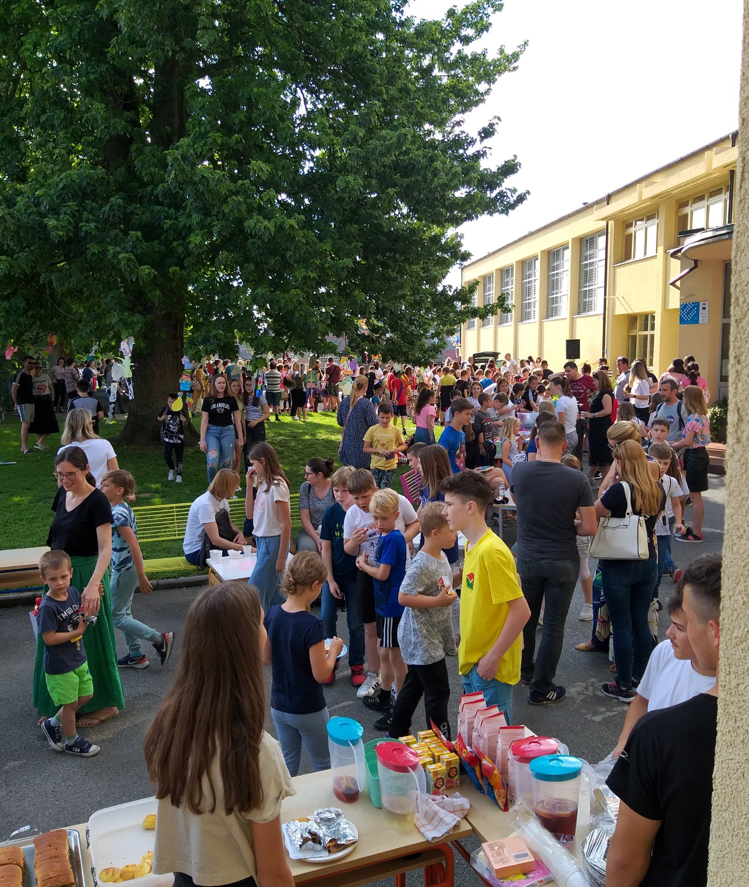

Slide 23
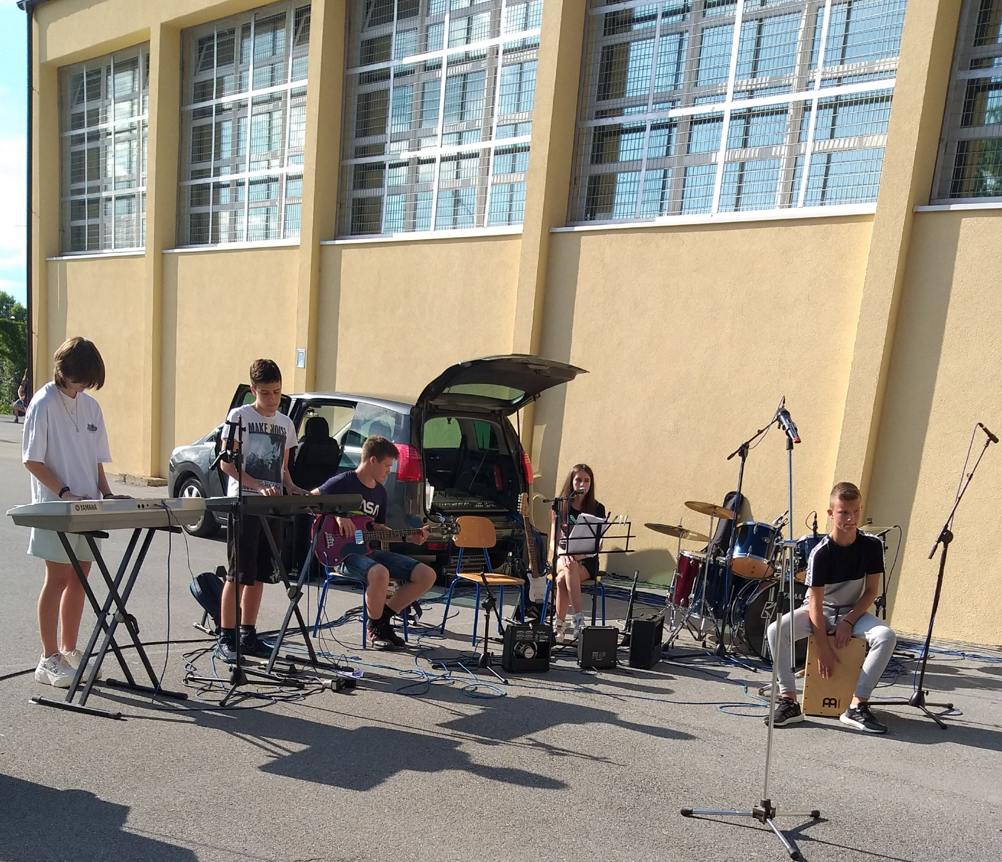

Slide 24
Thank you
for your attention !
V&V&S

