Slide 1
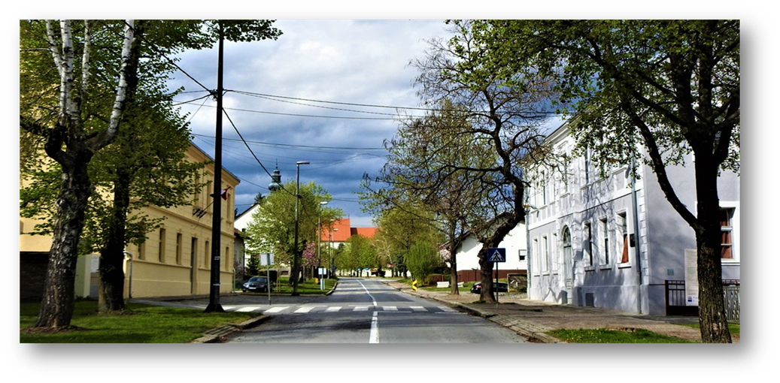
Primary school
Mate Lovrak
Kutina - Croatia

Slide 2

The town of Kutina is located 80 km southeast of Zagreb, the capital of Republic of Croatia, in the heart of Moslavina between the sloppes of Moslavačka gora and Lonjsko polje. The city developed because of the Petrokemija fertilizer factory, but today it is turning to new branches of the economy. So today, guests come on a tour of the wine roads, Regional Park Moslavčaka gora and Lonjsko polje. The MoslaVina wine festival is traditionally held in Kutina every year, where the Moslavina wine region and the autochthonous Škrlet wine variety are promoted.
https://www.youtube.com/watch?v=yiEYBDs6rvY

Slide 3
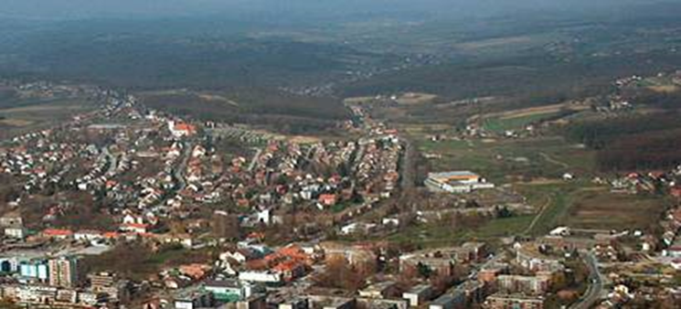
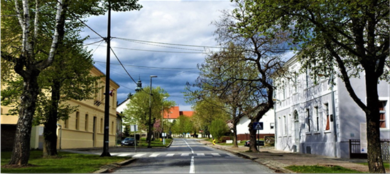
MATE LOVRAK PRIMARY SCHOOL -
located in the northern part of the city

Slide 4
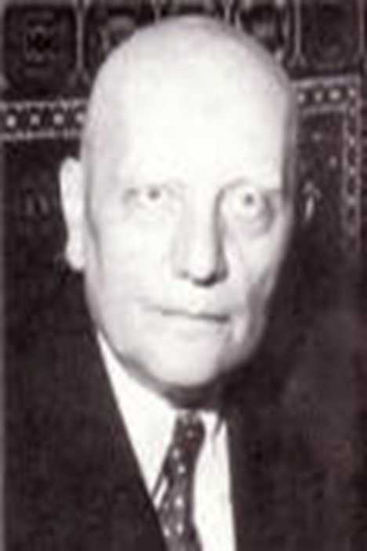
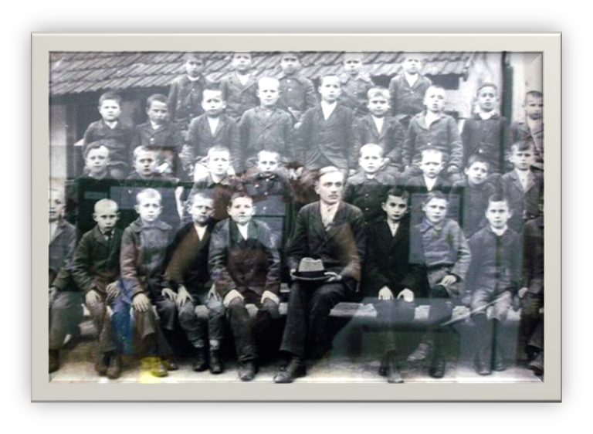
The school is named after well-known Croatian writer Mato Lovrak
He used to work at our school as a teacher - 1920.

Slide 5
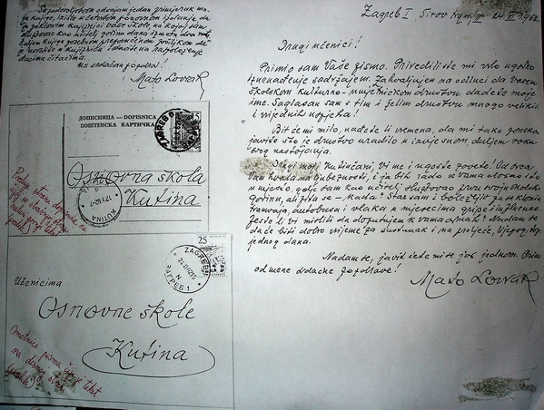
Letters from Mato Lovrak to students of our school - 1962.god.

Slide 6
Our school is a really old lady
It was built in 1789.
This year we are celebrating the 235th anniversary of the school.
We are proud that our school is in a historical monument category.
With the support of European funds, the school was renovated and although very old - today it is a very modern school with modern teaching methods.

Slide 7
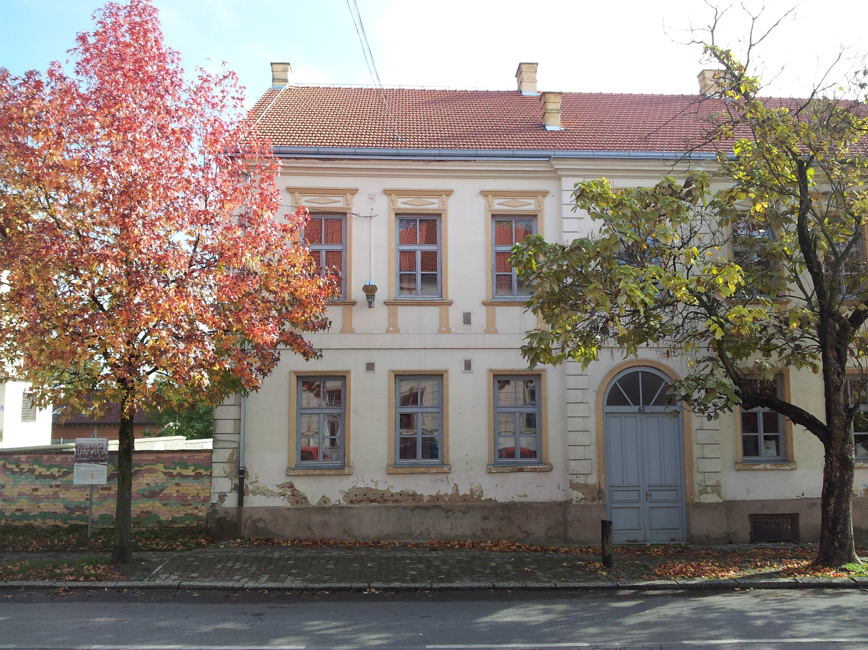
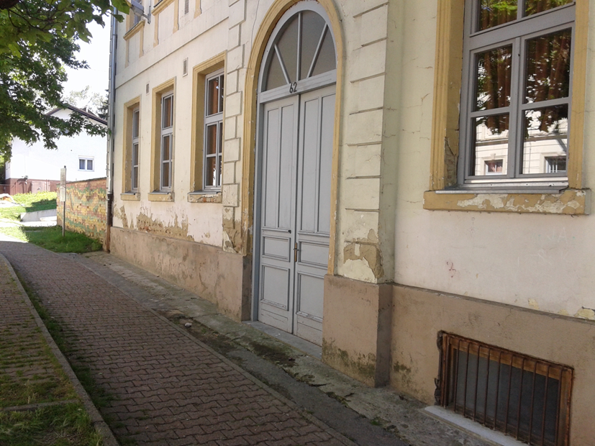
Before renovation :

Slide 8
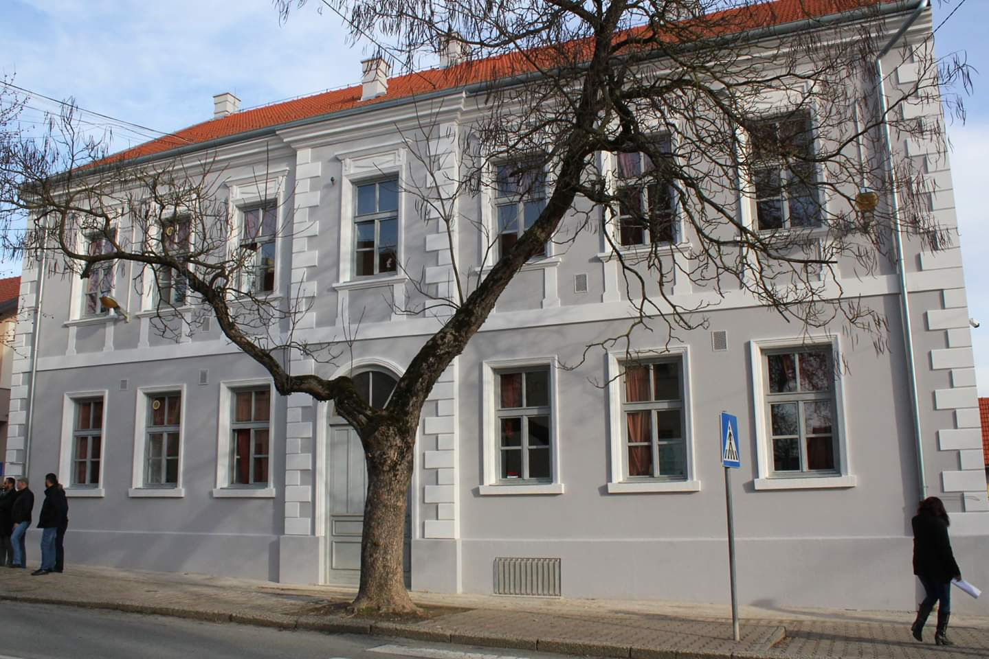
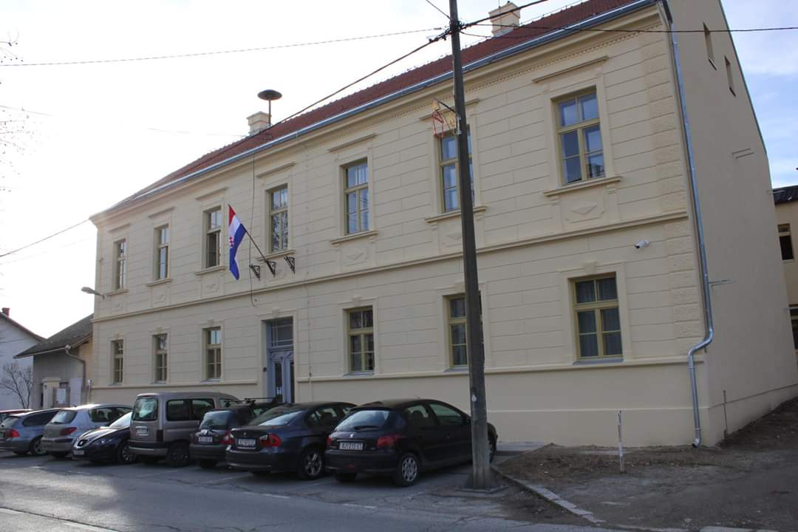
After renovation :

Slide 9

School LOGO

Slide 10
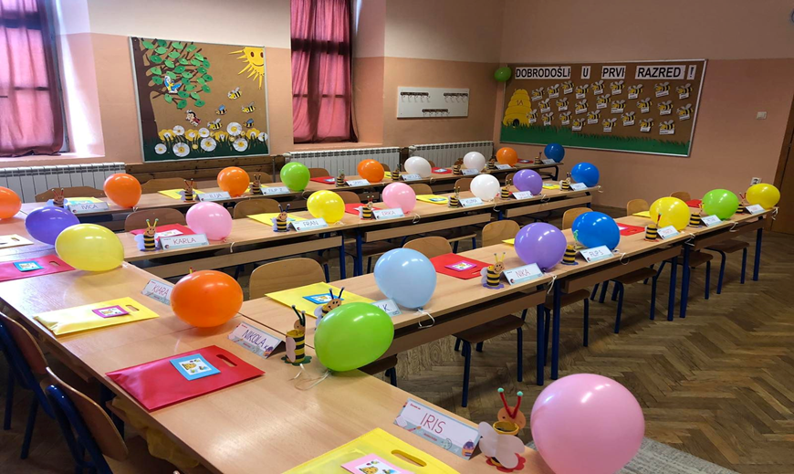
The school is attended by students aged 6–14 years
There are about 400 students in the school.

Slide 11
Teaching & activities :
We have obligatory subjects and elective courses like German, Religion and Computer Science.
We also offer various extracurricular activities : Astronomy, Computer Science, Choir, School Band, Art, various sports, Contemporary Dance, Drama, Journalism, Literary Club, Ecology, Italian Language, Traditional Skills, Household…etc.
Pupils participate in numerous competitions and achieve excellent results.

Slide 12
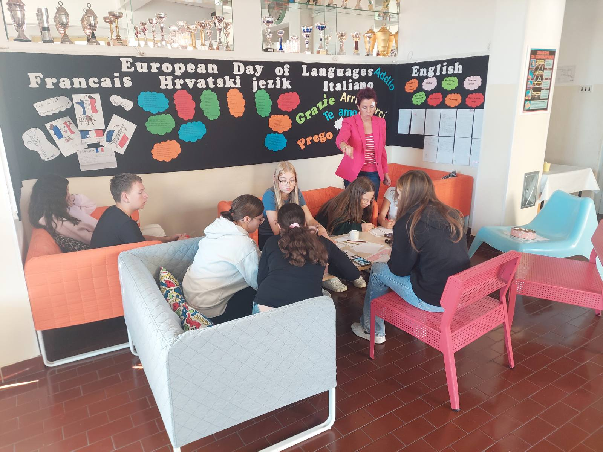
Traditional Skills

Slide 13
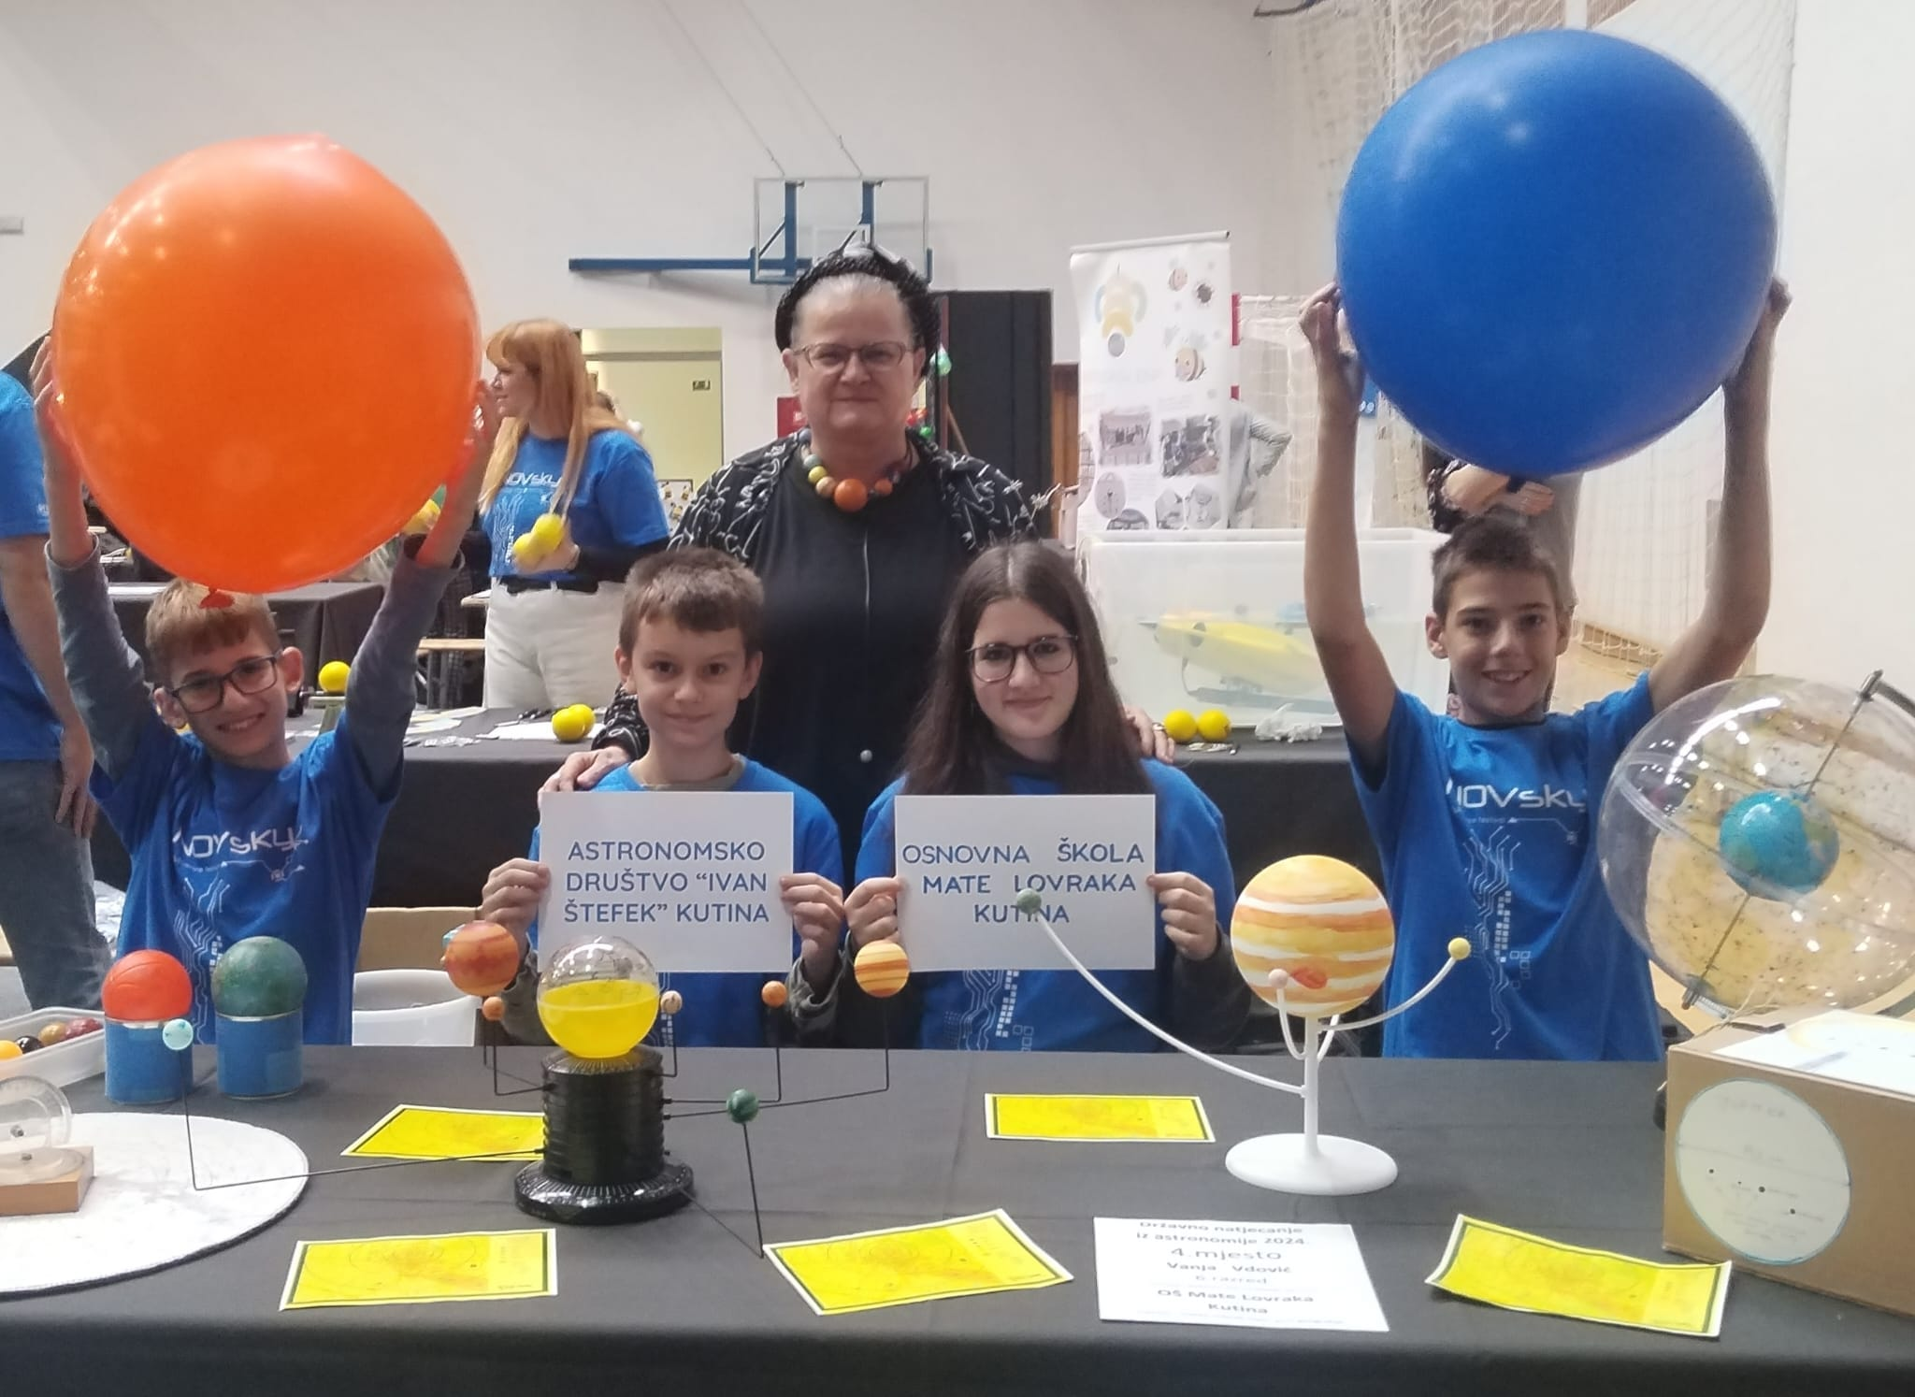
Astronomy

Slide 14
PROJECTS
We participate in numerous projects organized by the Ministry of Science and Education, the county, the city or in our school projects. We have also been active in e-Twinning projects for a decade now, and we have ongoing Erasmus projects as well.
Through the e-school project and STEM-alphabet of the future project, we received numerous IT equipment, which makes us the most modern school in the Republic of Croatia at the moment. Each class has its own desktop computer, projector, smart board, whiteboard. The IT classroom has 22 laptops and desktop computers for students. We have VR glasses, 3-d projectors, etc

Slide 15
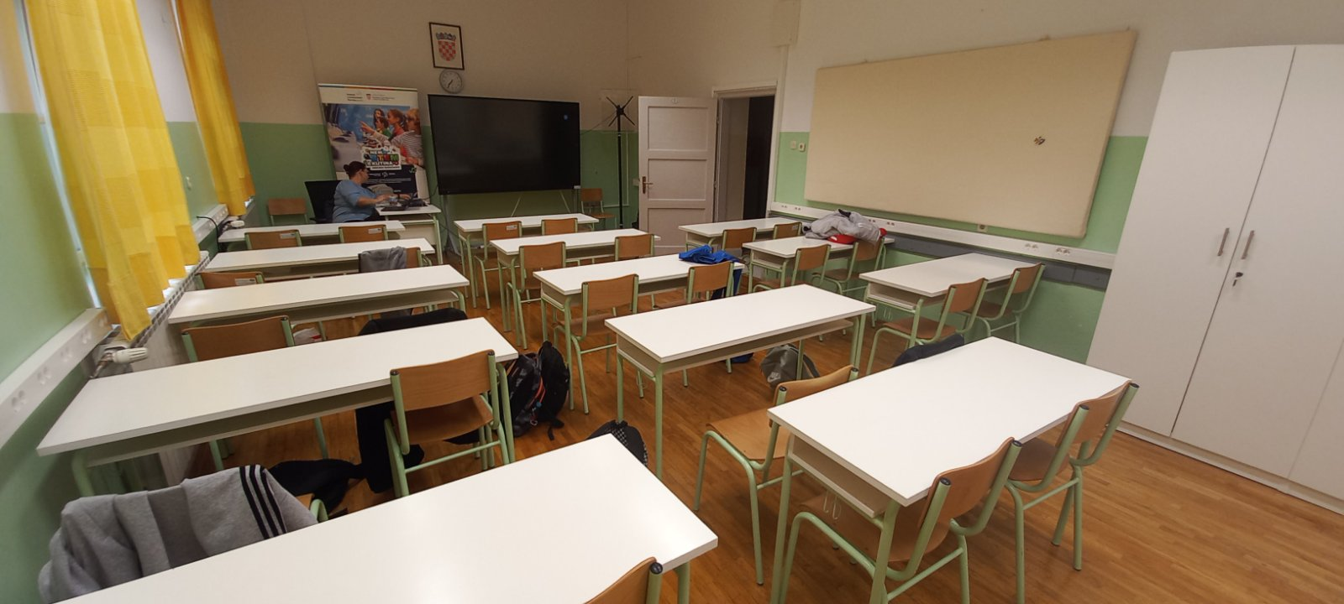
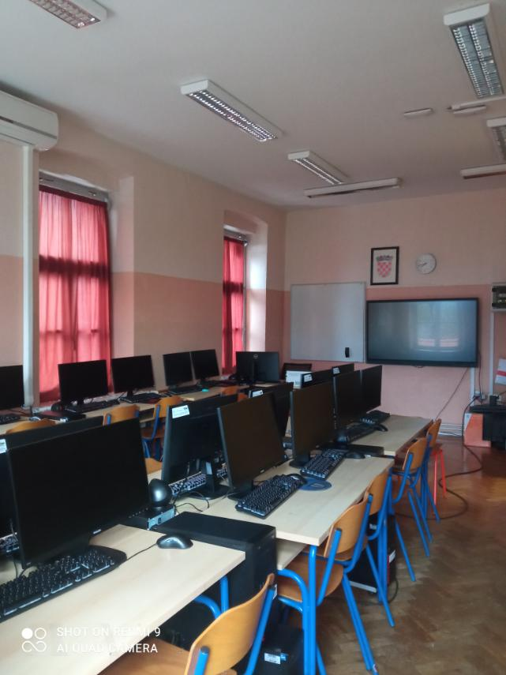

Slide 16
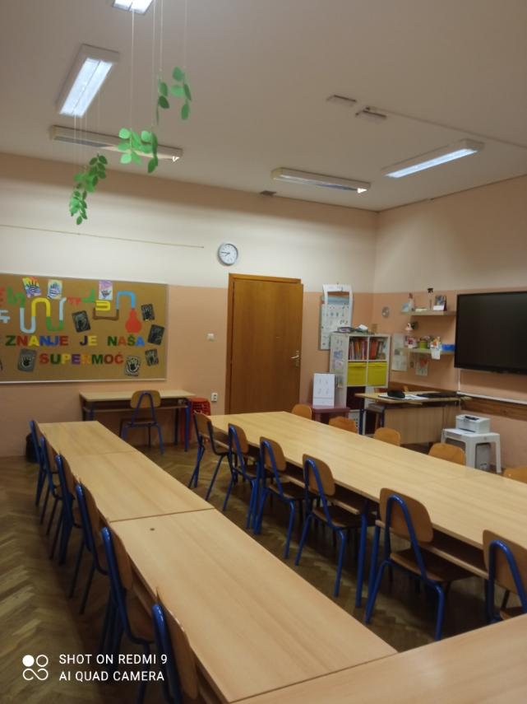
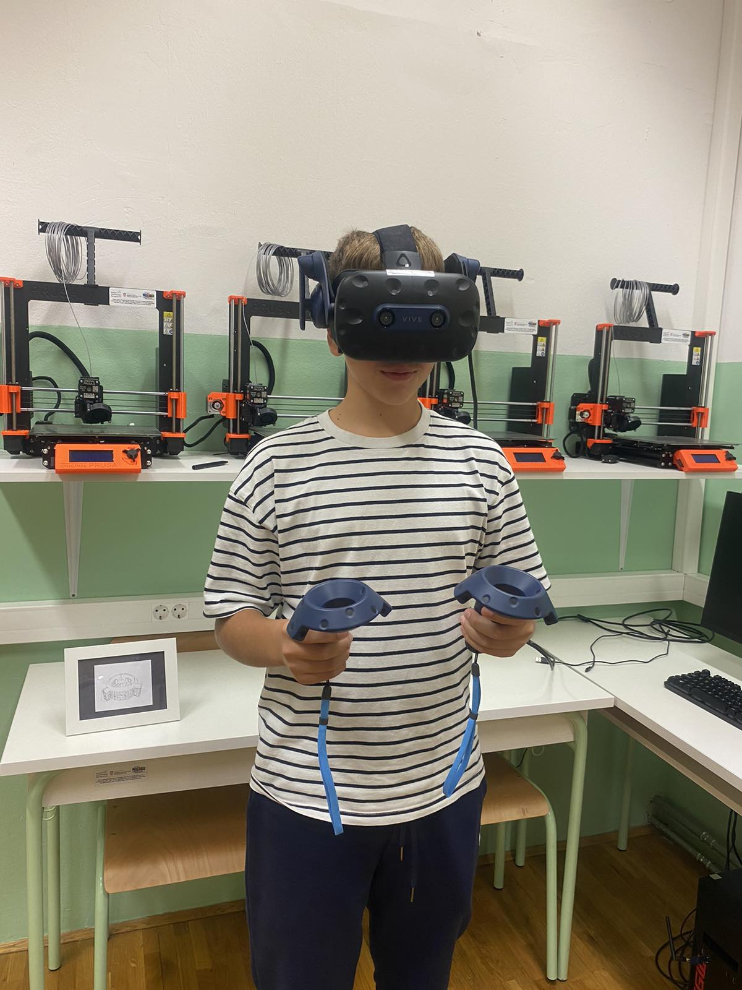

Slide 17
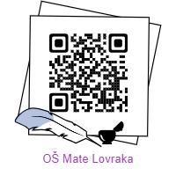

OŠ MATE LOVRAKA, KUTINA
SCHOOL WEBSITE
SCHOOL FACEBOOK

Slide 18
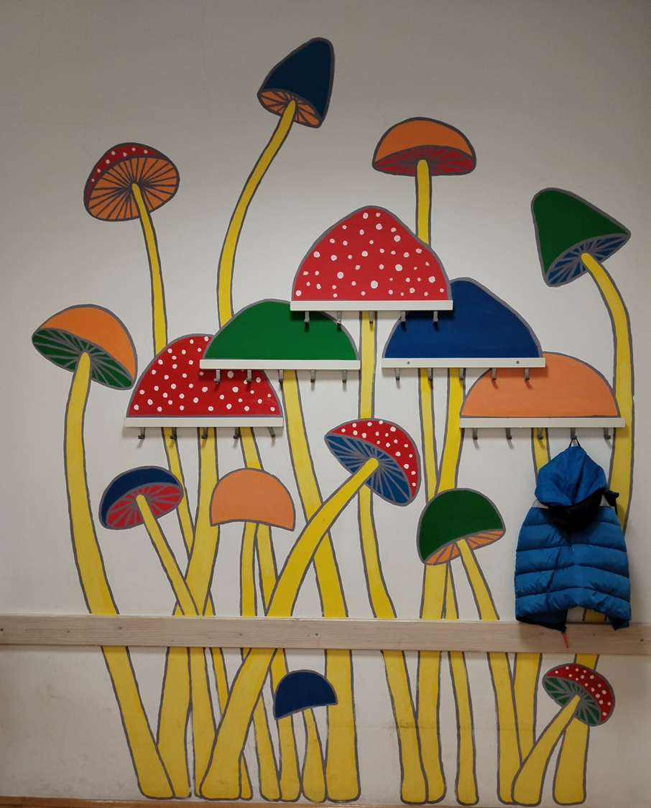
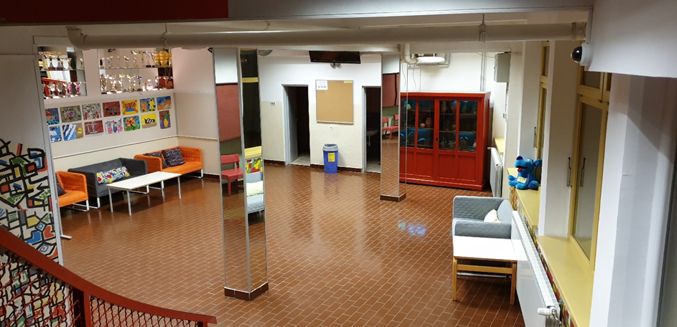
A short photo tour through school and activities …

Slide 19
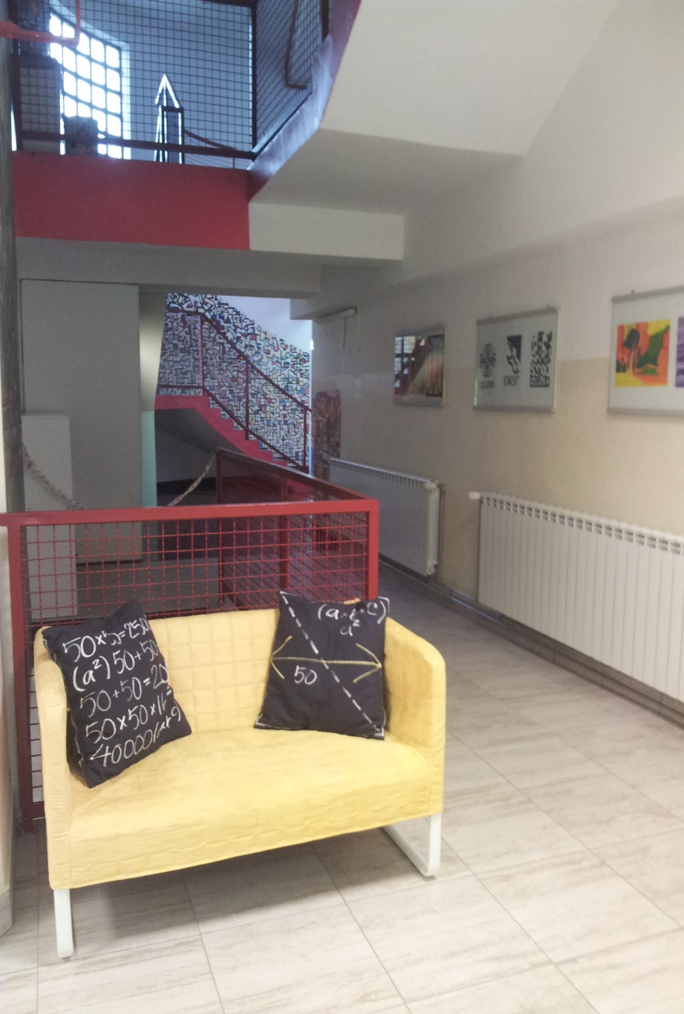
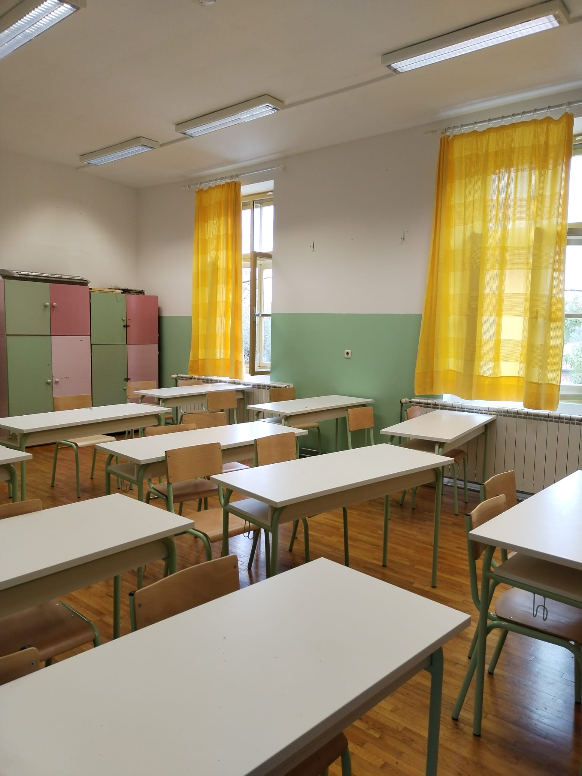

Slide 20
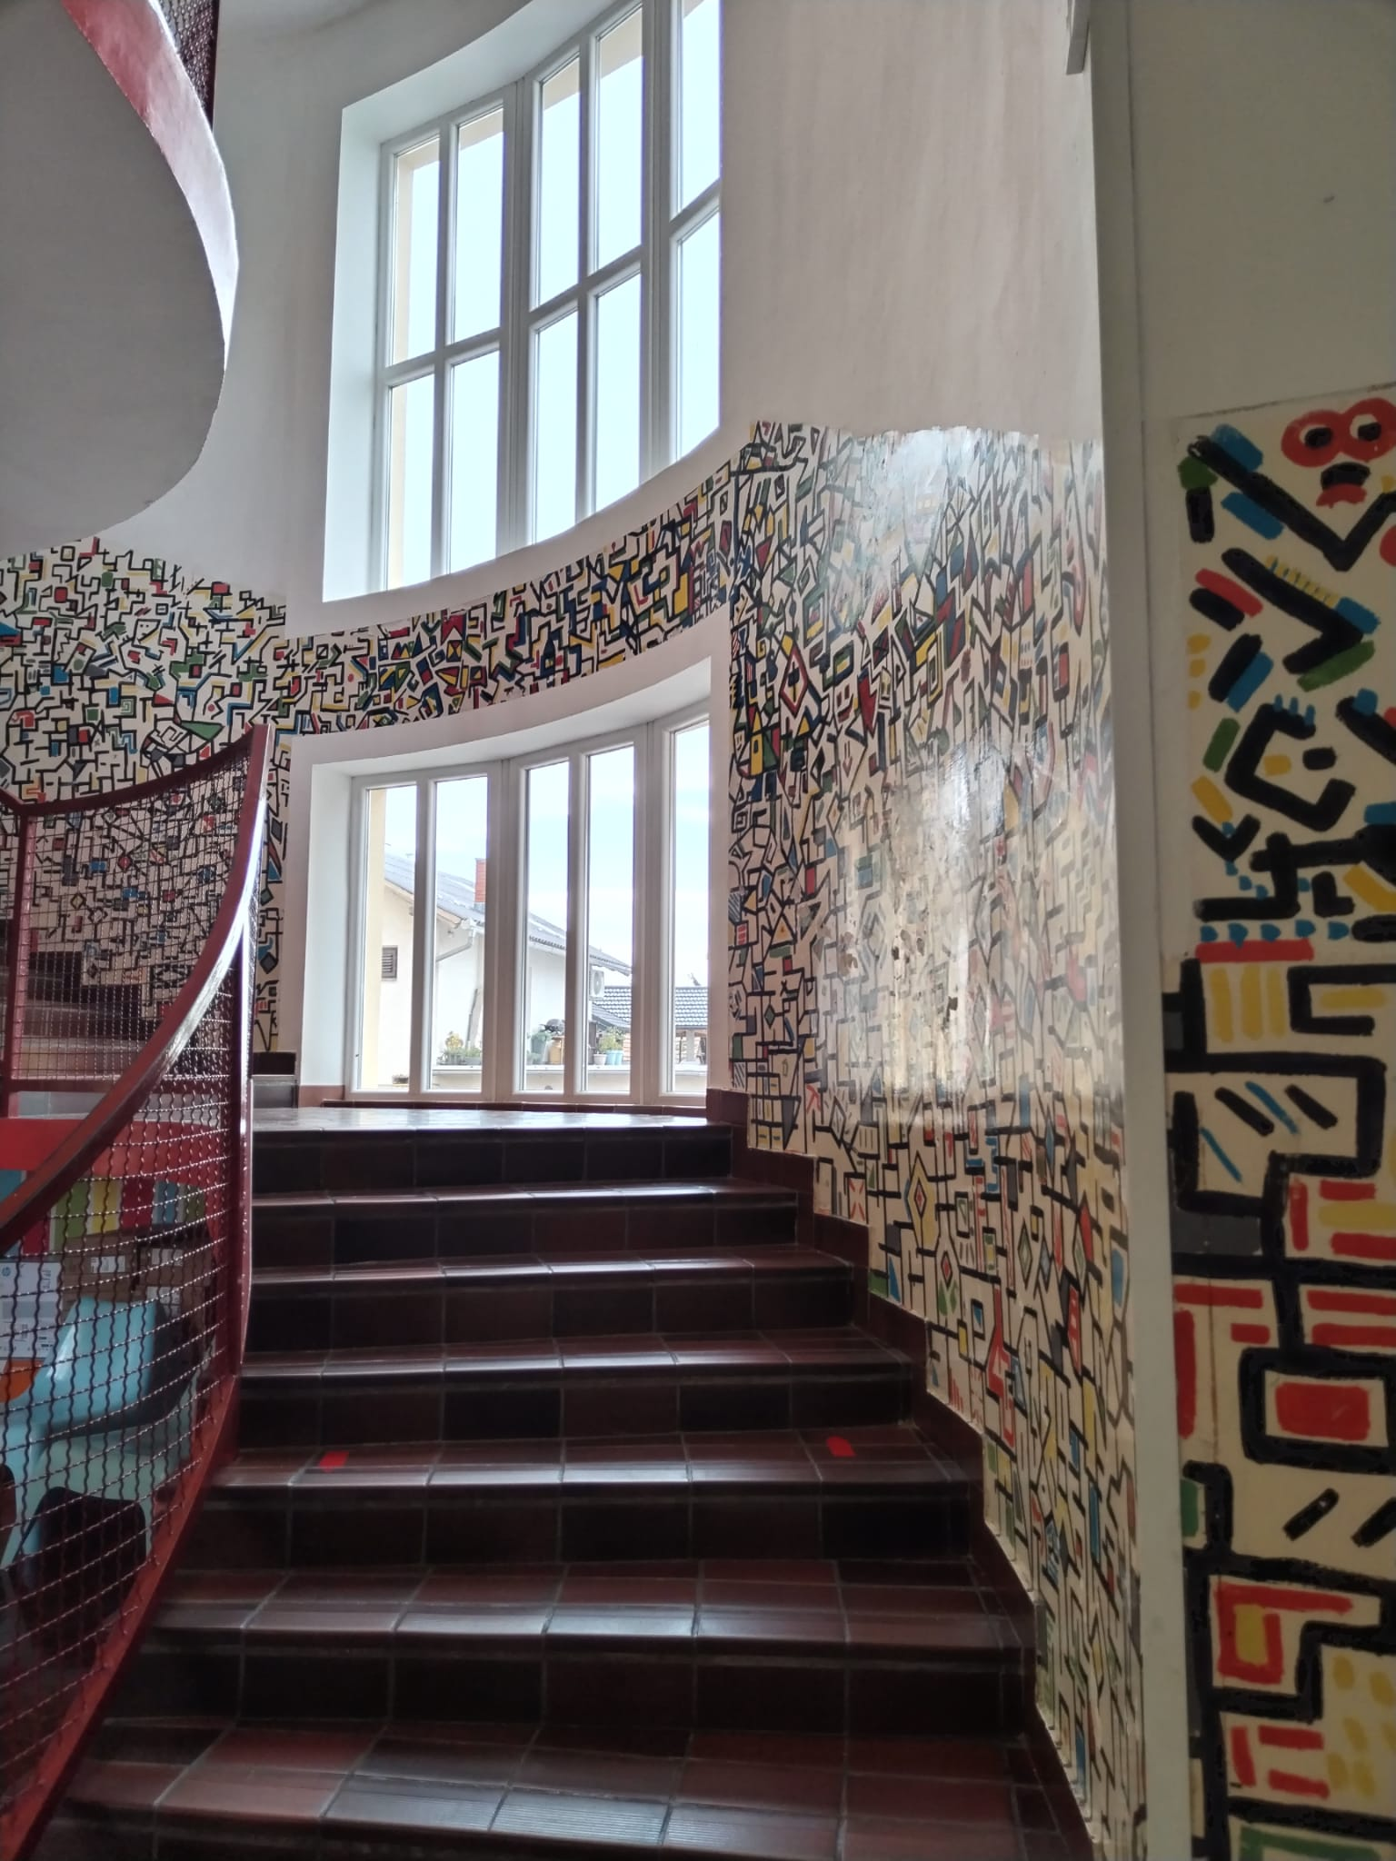
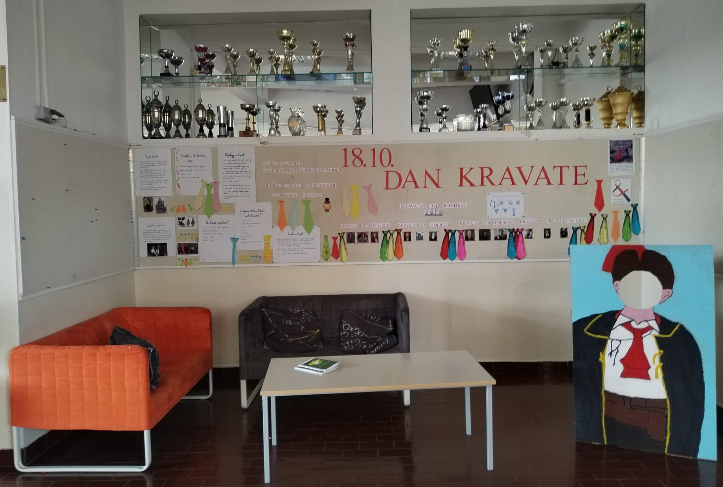

Slide 21
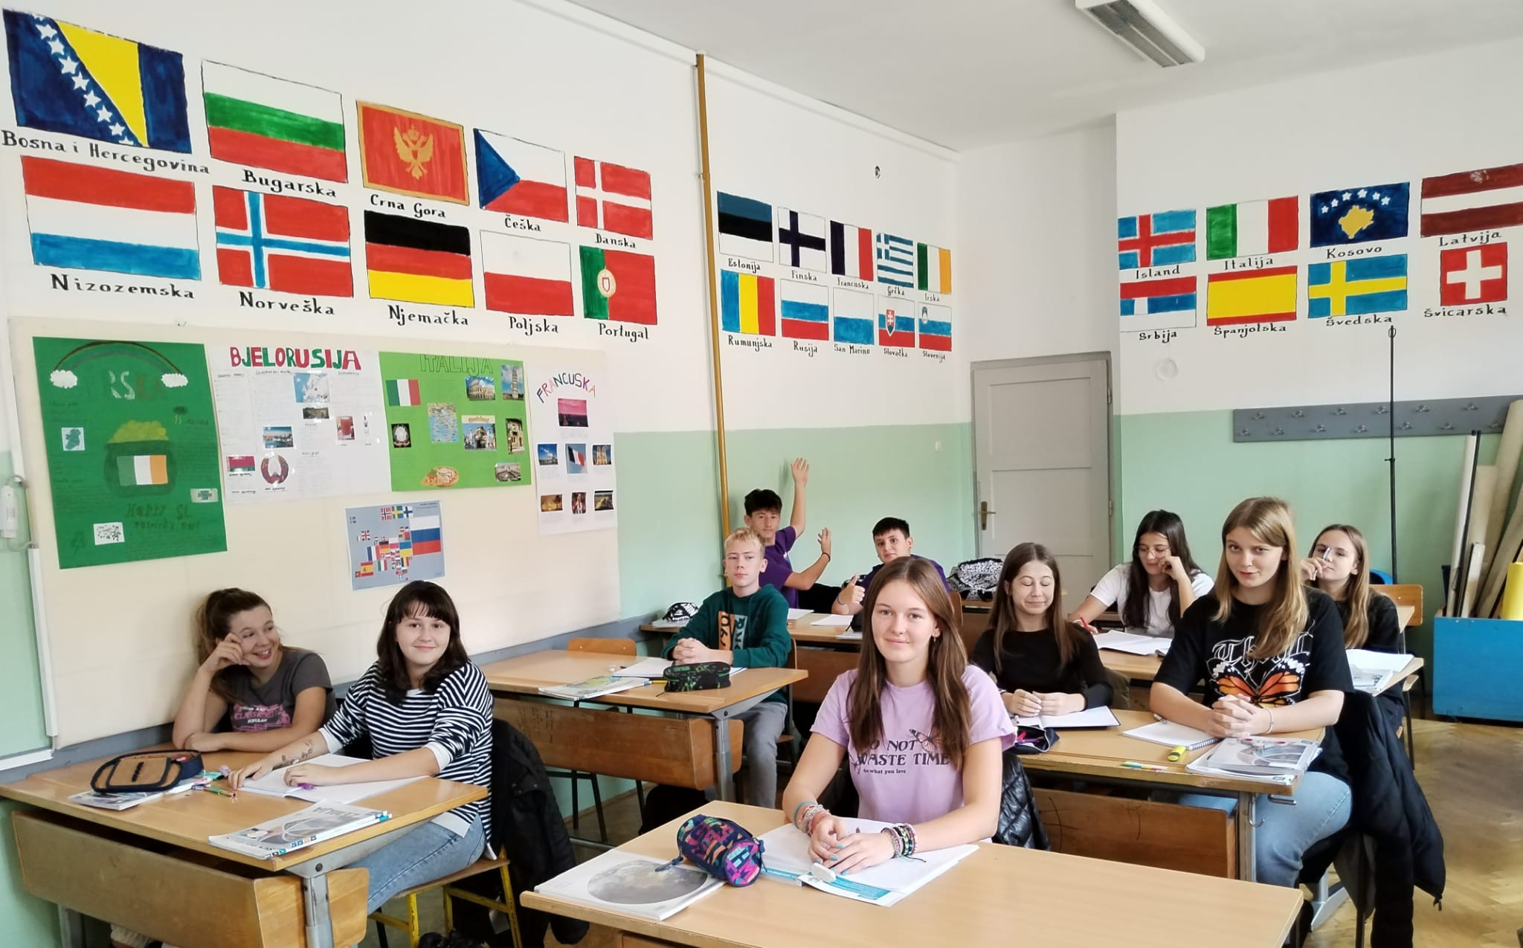
ASTRONOMY CLUB

Slide 22
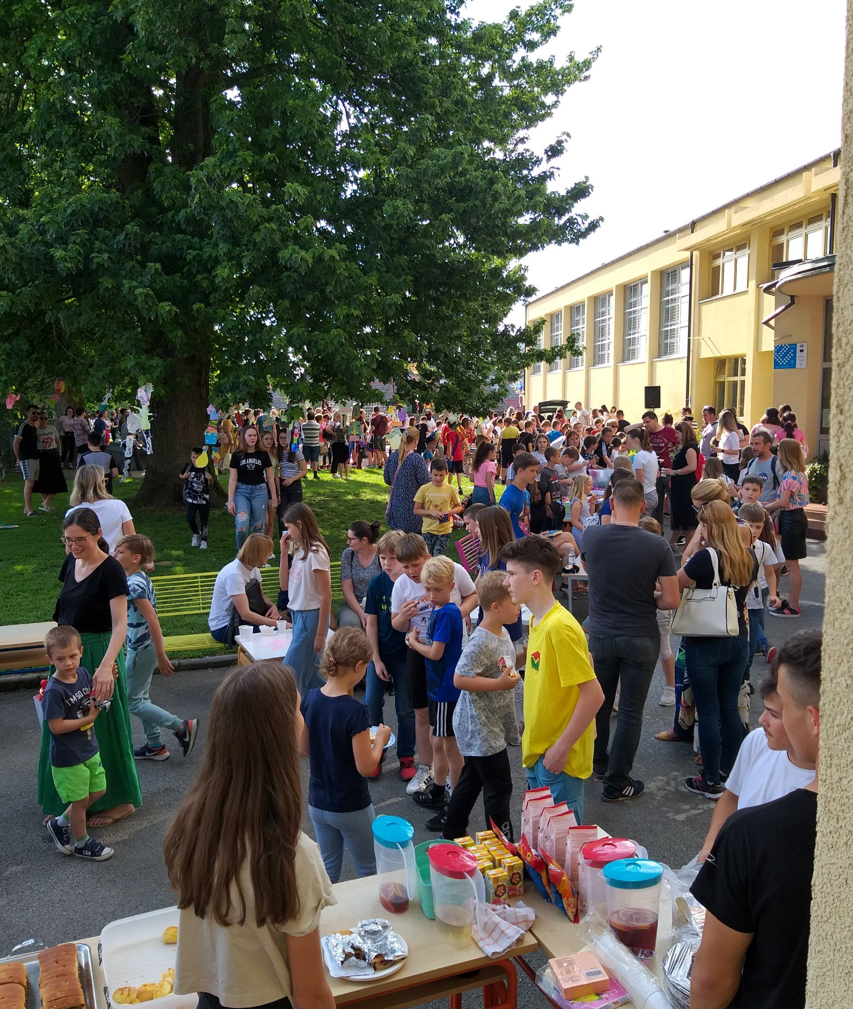
BUVLJAK-SALES FARE

Slide 23
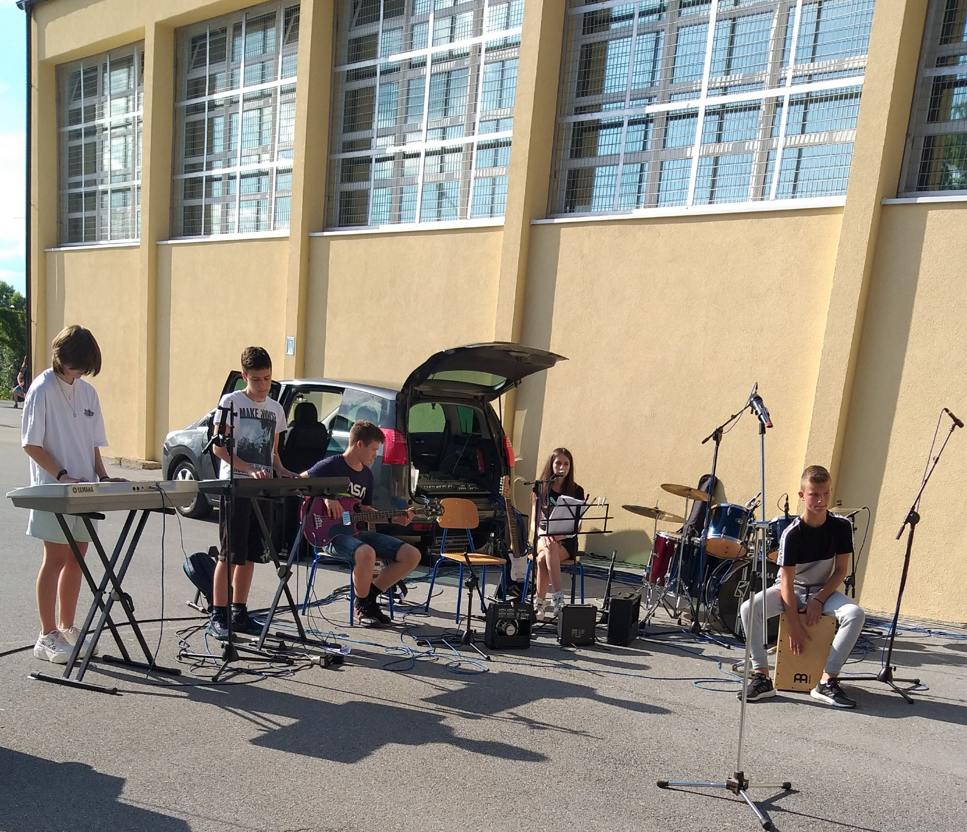
SCHOOL BAND

Slide 24
Thank you
for your attention !
MATERIJALE NAPRAVILE I UREDILE: MAJA MERHAUT-KOVAČEVIĆ I SANJA KOS

